Slide 1
Software Development life Cycle
By-
Sandhiya S,
Sharan S,
Saran R

Slide 2
Types of SDLC Models
SDLC:
The Software Development Life Cycle (SDLC) is a structured process followed to design, develop, test, and deploy software applications.
It provides a systematic approach to creating high-quality software.
Waterfall Model
Iterative Model
V Model
Spiral Model
Agile Model
Devops Model

Slide 3
Waterfall Model

Slide 4
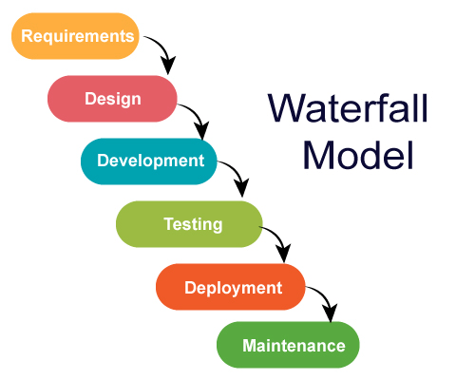
linear and sequential model.
Similarly, waterfall model also works, once one phase of development is completed then we move to the next phase but cannot go back to the previous phase. In the waterfall model, the output of one phase serves as the input for the other phase.
We cannot overlap phases in waterfall model.

Slide 5
Advantages:
This model is simple and easy to understand.
This is very useful for small projects.
there is no overlapping between the phases.
Disadvantages:
complete and accurate requirements are expected
We cannot go back to the previous phase due to which it is very difficult to change the requirements.
In this the testing period comes very late.
When to use :
Clear and Stable Requirements.
Simple or Low-Risk Project.
Example:
Government or Defense Projects.

Slide 6
Iterative Model

Slide 7
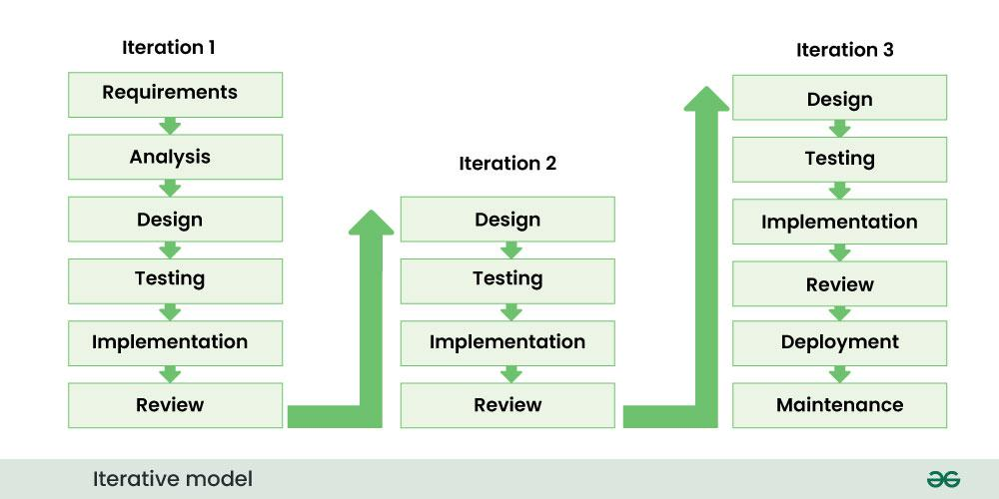
Iteration - repeating the development process again and again.
we start developing the software with some requirements and when it is developed, it is reviewed. If there are requirements for changes in it, then we develop a new version of the software based on those requirements.
The iteration will be repeated until the complete software is ready.
basic concept - the software should be developed through repeated cycles.

Slide 8
Advantages:
This model is easily adaptable to constantly changing needs.
Risks are identified and resolved during iteration.
Testing and debugging the software becomes easier during each iteration.
Disadvantages:
Iterative model is not suitable for small projects.
the budget of the project is high.
takes more time to complete
When to use :
Complex or Large Projects
Projects Requiring Regular Feedback
Example:
Web and Mobile Applications
Education and Training Platforms

Slide 9
V Model

Slide 10
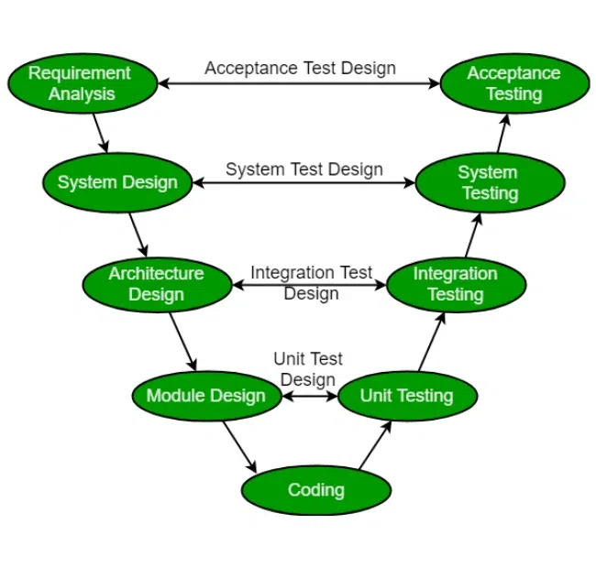
Extension of the traditional waterfall model
Known as the Verification and Validation model.
Testing is associated with every phase of lifecycle.
Verification Phase(Requirement analysis, System design, Architecture design, Module design.
Validation Phase( Unit testing, Integration, System, Acceptance testing)
V-Model stresses that testing should begin as soon as the requirements are defined.

Slide 11
Advantages:
Time Saving
Quality will be good.
Early Detection of Defects.
Disadvantages:
No feedback so less scope of changes
Not Ideal for Complex or Unclear Requirements.
When to use :
Small to medium-sized projects.
Projects where requirements are unlikely to change.
Projects where early testing and validation are critical..
Example:
Military.

Slide 12
Spiral Model

Slide 13
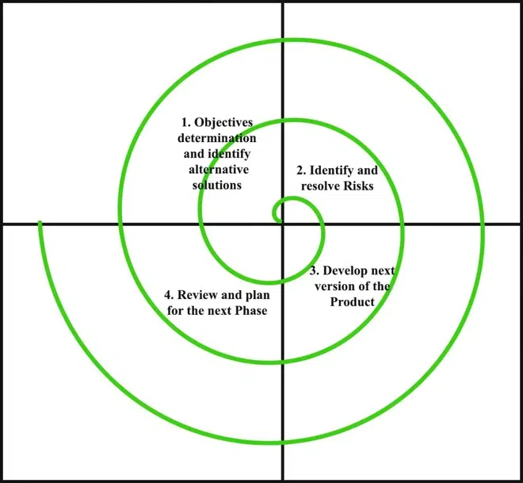
combination of the waterfall model and the iterative model.
The Spiral Model process involves four key phases: Planning (gather requirements), Risk Analysis (identify and mitigate risks), Engineering (develop and prototype), and Evaluation (gather feedback). These phases repeat in cycles, allowing for iterative development, continuous refinement, and frequent customer input, ensuring adaptability and risk management throughout the project.
The Spiral Model incorporates regular customer feedback after each iteration,

Slide 14
Advantages:
This model has early identification of risks.
Allows for changes to be incorporated throughout the development process.
Regular customer feedback helps with the development.
Disadvantages:
Spiral Model can be difficult to manage due to its complexity
Not Suitable for Small Projects.
Can Be Hard to Define Milestones.
When to use :
Large and complex projects.
Expensive.
Example:
Gaming Industry.

Slide 15
Agile Model

Slide 16
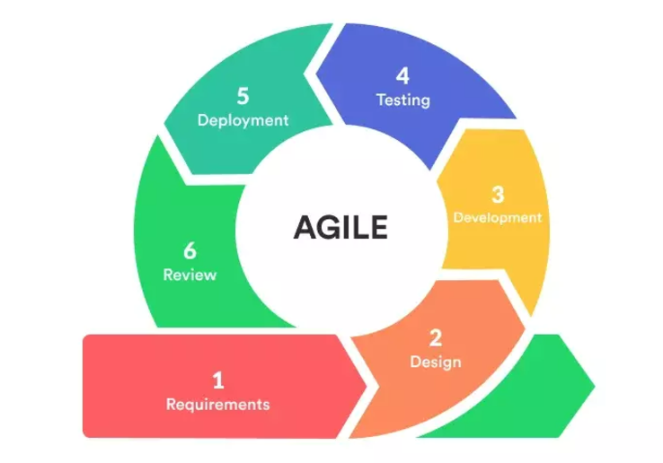
What is Agile?
Agile is a term that describes approaches to software development that emphasize incremental delivery
Team collaboration
Continual planning and continual learning
Adapt quickly to change requests
Scrum Methodology
Extreme Programming

Slide 17
Advantages:
Functionality can be developed rapidly and demonstrated
Little or no planning required
Easy to manage
Disadvantages:
Depends heavily on customer interaction
More risk of sustainability, maintainability and extensibility
Not suitable for handling complex dependencies
When to use :
Large and complex projects.
When requirements are unclear or expected to evolve
Example:
Paypal (scrum), Spotify (Squads)

Slide 18
DevOps Model

Slide 19
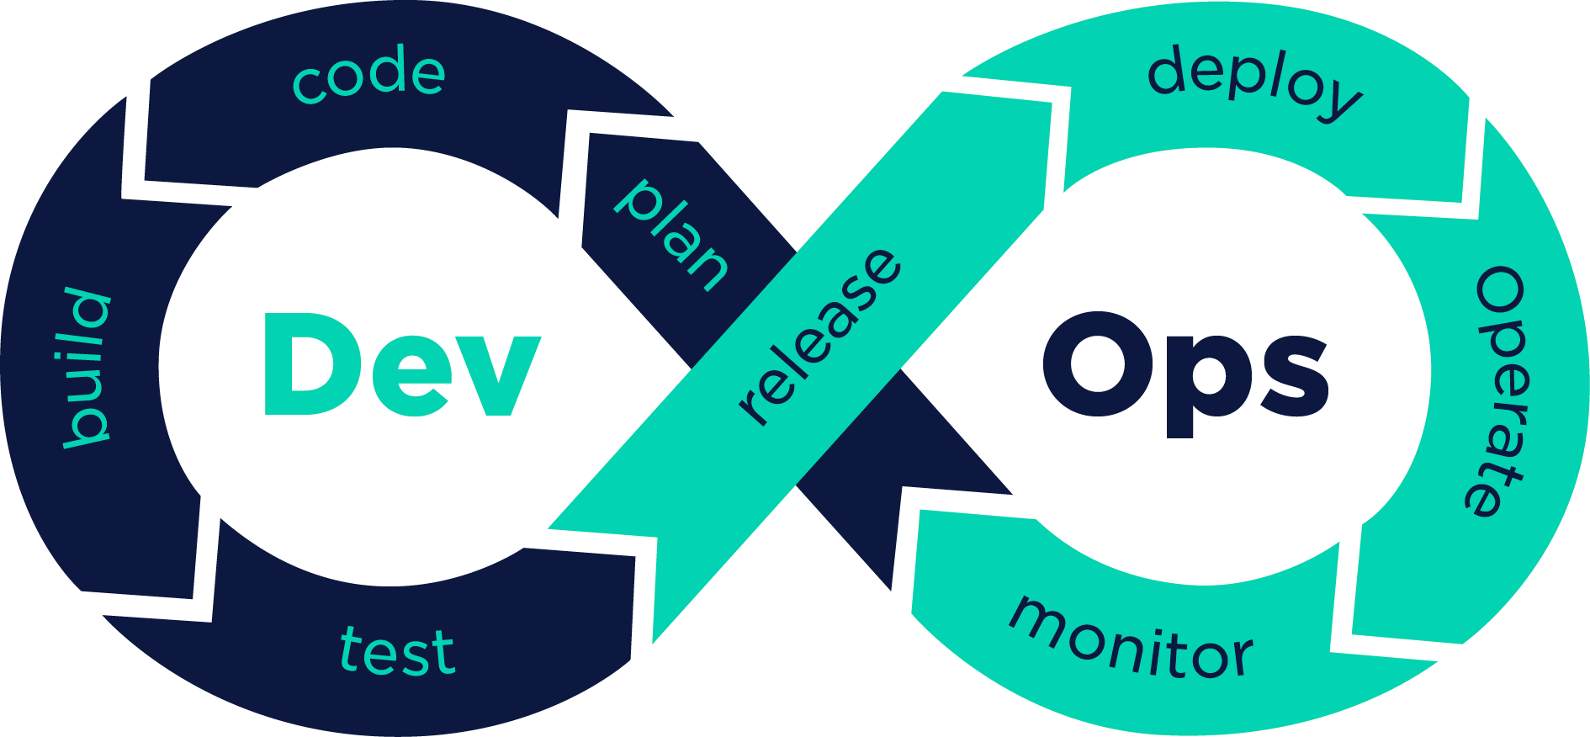
What is DevOps Model?
The term “DevOps” refers to the Development and Operations of software development
Continuous Integration (CI)
Continuous Delivery (CD)
Monitoring
Microservices Architecture
DevSecOps

Slide 20
Advantages:
Faster development and deployment of applications
Faster response to the market changes to improve business growth
Easy to manage
Disadvantages:
Less availability of DevOps professionals
Infrastructure cost is high for setting by DevOps environment
When to use :
Manufacturing, healthcare and finance
Example:
Amazon, Large scale healthcare's

Slide 21
Thank you

